Slide 1

SYS.TS: INITIALIZATION
Early Detection of Money Laundering Rings using Temporal Transaction Network Analytics and Explainable Risk Scoring
A Temporal, Pattern-Aware and Explainable Forensic Analytics Framework
RESEARCH CANDIDATE
PROJECT THEME
SYSTEM STATUS
M.Tech Integrated CSE — Business Analytics
Temporal Network Analytics
WORKING RESEARCH PROTOTYPE
[REAL-DATA AML FORENSIC ANALYTICS SYSTEM]

Slide 2



SYS.TS: [ANALYSIS_MODE]
Problem, Research Question & Novelty
Research Gaps
Proposed Novelty
Static transaction analysis misses temporal evolution of money flow.
TEMPORAL GRAPH ARCHITECTURE
Single-pattern detection can miss combinations of suspicious behaviours.
Modeling financial systems as directed temporal graphs (Nodes: Accounts, Edges: Transactions).
Black-box risk scores provide limited investigator-readable evidence.
PATTERN TRAJECTORY ENGINE
Tracking suspicious-pattern evolution across temporal windows and combining complementary behavioural signals into bounded trajectories.
Detection systems may identify suspicious rings only after multiple laundering behaviours become visible.
EXPLAINABLE RISK SCORING
Multi-component risk (Behavioural, Network, Fund Flow, Persistence) with forensic evidence.
LEAD-TIME MEASUREMENT
Quantifying early-warning performance using temporal lead-time metrics vs ground truth.
RESEARCH CONTRIBUTION
An integrated formation-stage AML framework that combines temporal transaction-pattern trajectories, explainable multi-factor risk scoring, forensic evidence generation and explicit lead-time evaluation.
"Can temporal transaction networks identify the formation of suspicious rings early and explain why they are risky?"
Slide 2 | Source: Project Objective & Research Gap

Slide 3

SYS.TS: [DATASET_EXPLORER]
AMLSim Dataset & Data Quality
197,905
12,043
720
100
671
TRANSACTIONS
ACCOUNTS
TIME WINDOWS
AML ALERTS
ALERT TXS
Ground Truth Distribution
Preprocessing Pipeline
Alert Category
Count
Description
1
Timestamp Parsing & Normalization
Cycle
40
Circular flow of funds
2
Sender/Receiver Identity Validation
Fan-in
30
Consolidation to one account
3
Amount Cleaning & Self-Tx Detection
4
Chronological Ordering
Fan-out
30
Dispersal to multiple accounts
Data Integrity Verification:
Rows In: 197,905 | Rows Out: 197,905
Result: 197,905 / 197,905 rows retained after preprocessing; no transaction rows were removed.
AMLSim ground truth: synthetic banking transactions with known AML typology alerts used for evaluation.
Slide 3 | Dataset: IBM AMLSim (Anti-Money Laundering Simulator)

Slide 4
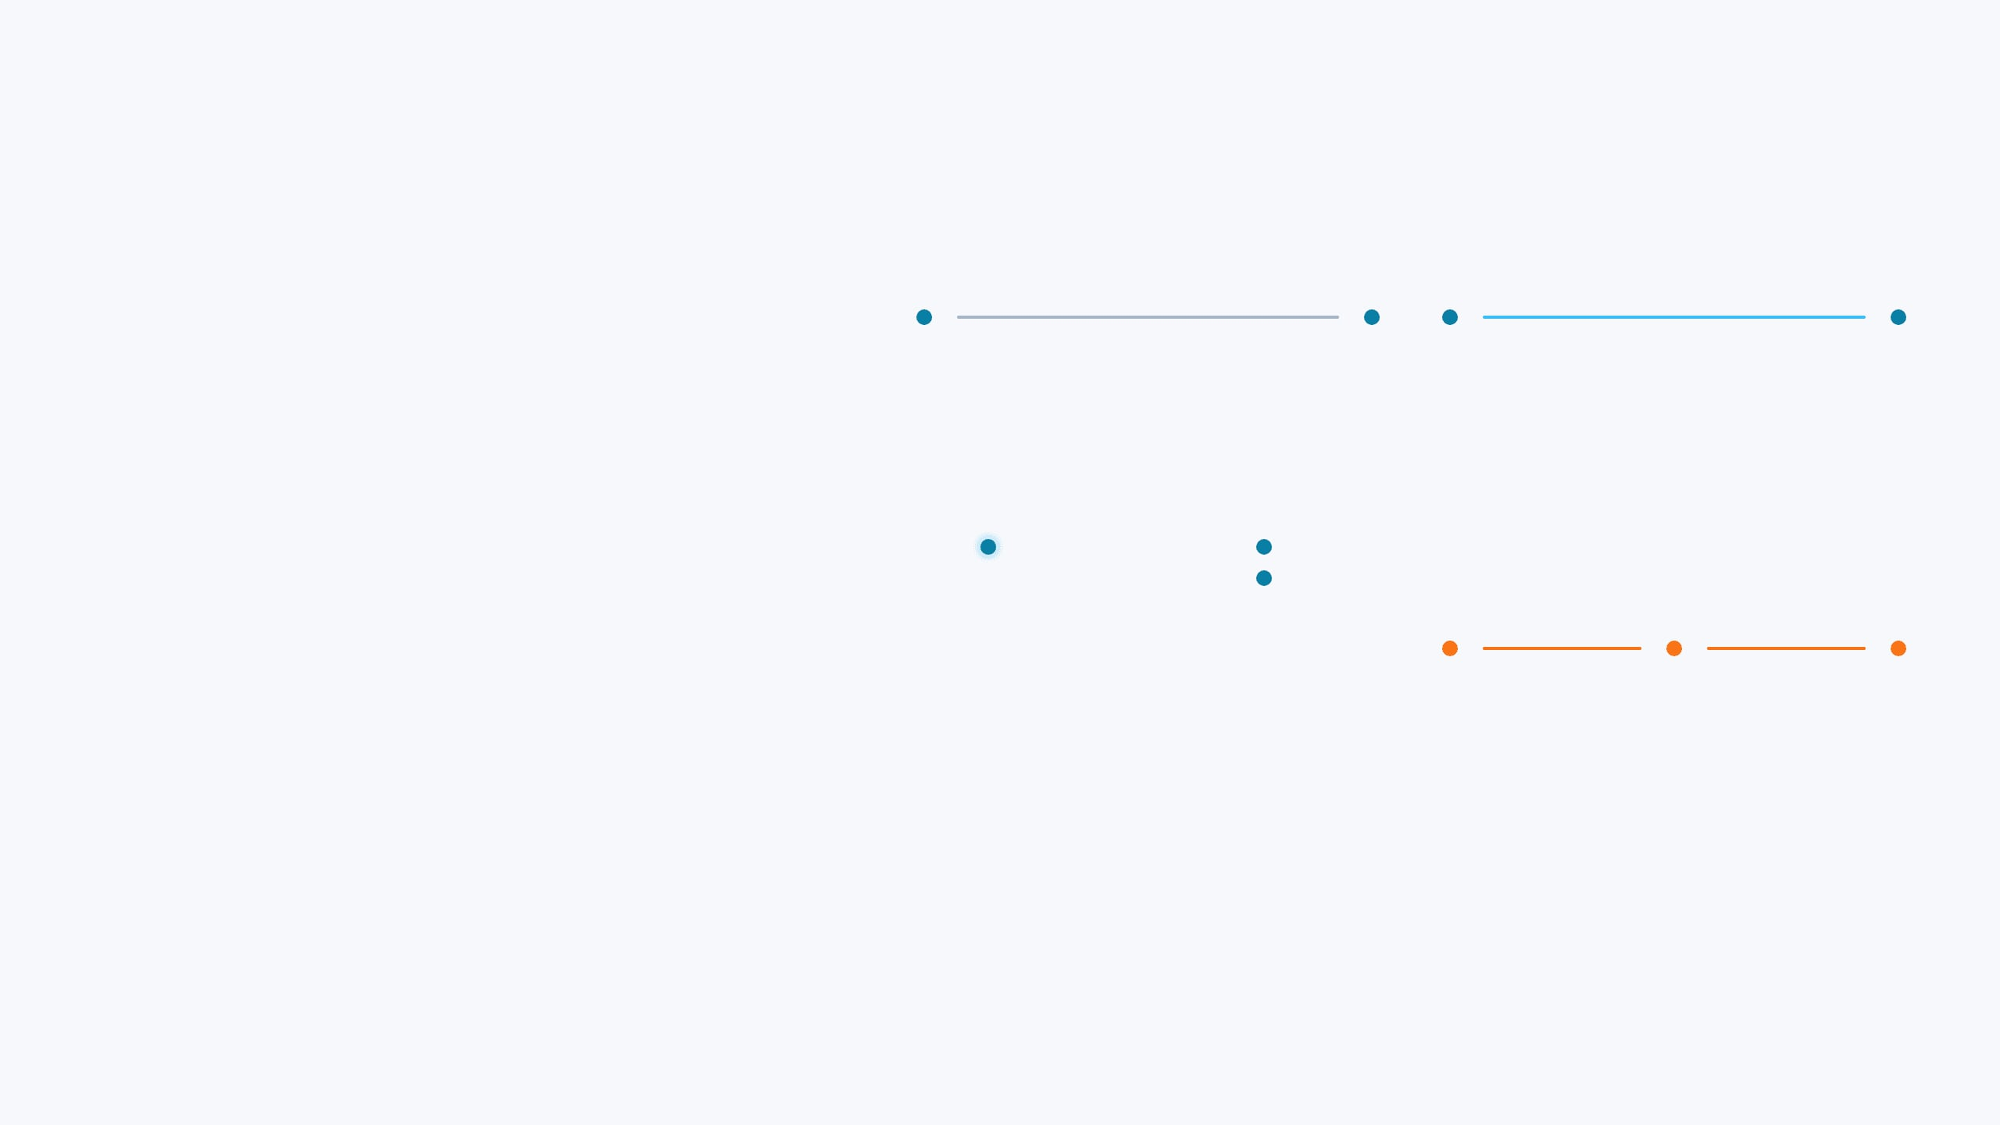
Temporal Transaction Network
SYS.TS: [GRAPH_ENGINE]
Graph Definition
Illustrative Temporal Graph Evolution
Nodes (V): Accounts
WINDOW 001
WINDOW 015
Edges (E): Transactions
Weight (W): Amount
Time (T): 720 one-day temporal windows
A temporal window is a fixed time interval in which transactions are grouped and analyzed as a graph snapshot.
Baseline transaction activity
Increased transaction velocity
Temporal Significance:
G(t1) ≠ G(t2). Modeling money laundering as a temporal process rather than a static event enables detection of changing connectivity, velocity, and pattern persistence.
WINDOW 032
WINDOW 050
Emerging structural pattern
More complex suspicious connectivity
Slide 4 | Framework: Temporal Graph Evolution Analysis

Slide 5

Feature Engineering & Forecasting
SYS.TS: [FEATURE_MODELING]
Feature Taxonomy (53 Total)
Chronological Split
The Imbalance Challenge
GRAPH FEATURES
Train (w0–431)
1,426,147 rows
Positive Test Rate:
0.0049%
PageRank, Betweenness Centrality, Clustering
Coefficient, In/Out Degree, Weighted Degree,
Positives
333
Neighbor Count
Val (w432–575)
613,567 rows
TRANSACTION FLOW
Transaction Count, Total / Mean / Median / Std
Positives
59
Amount, Unique Counterparties, Amount
Concentration, Log Total Amount
Test (w576–719)
653,487 rows
TEMPORAL ANALYTICS
Positives
32
Transaction Velocity, Burstiness, Activity
Acceleration, Activity Persistence, Activity Trend
Slope
Forecast Horizon: 2 Windows
Observations: 2,693,201 total
DELTA (TEMPORAL SHIFT)
Δ Transaction Velocity, Δ Neighbor Count, Δ
EXTREME CLASS IMBALANCE:
Only 32 positive observations occur in the held-out test set. Therefore, ROC-AUC alone is insufficient; PR-AUC, precision, recall and investigator-oriented ranking metrics must also be considered.
Connectivity, Δ Degree, Δ Transaction Count, Δ
Transaction Amount
Slide 5 | Methodology: Account-Window Temporal Forecasting

Slide 6
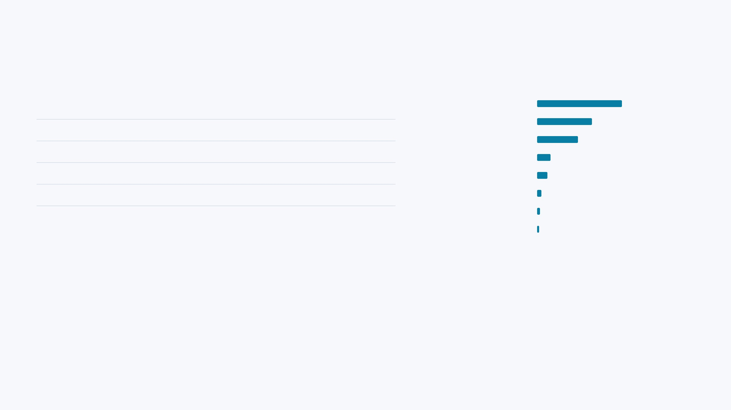
Model Comparison & Feature Importance
SYS.TS: [MODEL_EVALUATION]
Performance Metrics (Test Set)
XGBoost Feature Importance
Model
Precision
Recall
F1
ROC-AUC
PR-AUC
total_count
0.3403
Isolation Forest
0.0001
0.1875
0.0002
0.6603
0.0001
transaction_velocity
0.2206
Logistic Reg.
0.0007
1.0000
0.0014
0.9634
0.0006
unique_counterparties
0.1633
log_total_amount
0.0533
Random Forest
0.0007
0.6250
0.0015
0.9731
0.0155
total_amount
0.0408
Proposed XGBoost
0.2941
0.1563
0.2041
0.9750
0.0778
Δ tx_velocity
0.0164
Δ total_count
0.0114
delta_connectivity
0.0077
Primary predictors are transaction volume, transaction velocity and counterparty connectivity.
Interpretation: The model is useful for ranking account-window observations, but ring-level reconstruction remains a separate forensic task.
Held-out Test Set: 653,487 observations / 32 positives.
Investigator ranking: Precision@10 40% | Precision@20 25% | Precision@50 14%.
Slide 6 | Results: Validated Forensic Forecasting Metrics

Slide 7

AML Pattern Engine
SYS.TS: [PATTERN_ENGINE]
Suspicious Pattern Detectors
Generated Event Distribution
Fan-in
Fan-out
Rapid pass-through
27,668
Fan-in
10,891
Layering
Split-merge
Circular flow
933
Rapid pass-through
Repeated intermediary
Repeated intermediary
233
Layering
130
Circular flow
Escalating connectivity
Split-merge
14
Fan-out
0
Total Detected Events: 39,869
Escalating connectivity
0
Pattern detectors identify suspicious behavioural signals; they do not independently establish money laundering.
[Illustrative Network Topological Signal]
Slide 7 | Detection: Pattern-Aware Structural Analytics

Slide 8

Suspicious Pattern Trajectories & Ring Candidates
SYS.TS: [CANDIDATE_ENGINE]
Suspicious Pattern Sequence
142 Analytical Ring Candidates
Fan-in
WATCH
FORMING
Limited suspicious evidence.
≥2 structural suspicious signals.
Rapid pass-through
EMERGING
OBSERVABLE_RING
Multiple complementary patterns.
Strong multi-pattern evidence.
Layering
Circular flow
Each event belongs to a temporal window; multiple patterns may occur within the same window.
Maximum trajectory span: 10 days | Minimum structural evidence: 2 structural events
CRITICAL DISTINCTION:
Formation stages indicate analytical evidence maturity. They do NOT establish criminal guilt or confirmed laundering.
3,460 Bounded Trajectories
(Max 10-day span | Min 2 structural events)
Slide 8 | Generation: From Pattern Episodes to Candidate Rings

Slide 9
Explainable Risk Scoring — RING056
SYS.TS: [FORENSIC_EXAMPLE_RING056]
67.13
Forensic Factors & Evolution
Mean model probability ≈ 92.5%
Evidence-subgraph density ≈ 98th percentile
HIGH RISK
3 distinct pattern types detected
Evidence events across 7 participant accounts
Risk = (B×35%) + (N×20%) + (F×25%) + (P×20%)
Suspicious Pattern Sequence (Observed):
Window 145
Rapid pass-through
↓
Window 152
Circular flow + Fan-in
BEHAVIOURAL
NETWORK
92.54
97.89
FUND FLOW
PERSISTENCE
37.50
28.93
Slide 9 | Explanation: Multi-Factor Risk Decomposition

Slide 10

Forensic Evidence & Investigator Workflow
SYS.TS: [INVESTIGATOR_WORKFLOW]
Evidence Generation Pipeline
Investigator Decision Support
1
Candidate ID & Risk Score
[INVESTIGATION: RING056]
HIGH RISK: 67.13
2
Suspicious Account Set
Evidence Graph + Transaction Evidence
Tx ID
Sender
Pattern
3
Transaction Evidence Table
Candidate: RING056
Risk Score: 67.13 — HIGH
Participant Accounts: 7
4
Pattern Evidence Record
Evidence Transactions: 6
Evidence Subgraph: 6 nodes / 6 edges
5
Authoritative Subgraph
All displayed evidence must correspond to stored backend records; unavailable fields are shown as N/A.
Design Principle:
Every dashboard number has a clear provenance. Row-level data must match backend records; if unavailable, show "N/A" rather than fabricating.
Investigator workflow: Candidate + Risk Score → Participant Accounts → Suspicious Transactions → Pattern Evidence → Evidence Subgraph → Investigator Review.
DATA SOURCE: AMLSim + Project SQLite Database
Slide 10 | Interface: Forensic Decision Support System

Slide 11
SYS.TS: [EVALUATION_METRICS]
Ground Truth, Lead-Time Evaluation & Limitations
Ring-Level Forensic Evaluation
Critical Limitations & Interpretation
Matching Rule: ≥2 shared accounts + temporal overlap.
Evaluation Levels: ML metrics (ROC-AUC 0.9750) evaluate account-window ranking, NOT ring reconstruction success.
Sparse Labels: Only 32 positive observations in the test set strongly affects precision and reconstruction confidence.
1%
0%
Temporal Units: Lead time is measured in windows (720 total); conversion to days requires explicit config justification.
RING DETECTION RATE
EARLY DETECTION RATE
Ground Truth: 100 AMLSim alert events / 671 labelled alert transactions.
−23
98.9%
Honest Disclosure: Ring-level evaluation is limited by incomplete candidate-to-ground-truth linkage; aggregation does not reconstruct all AMLSim alert groups as the same candidate.
MEAN LEAD TIME (WINDOWS)
CANDIDATE FALSE-WARNING RATE
CAUTION: 98.9% of alerted candidates were unmatched to strict AMLSim ground truth (88 of 89 alerted candidates). This reflects limited candidate-to-ground-truth linkage: only 2 of 142 candidates achieved a strict match, and only 1 matched candidate crossed the alert threshold.
Negative lead time means the matched candidate warning occurred after the AMLSim observable event: −23 windows means 23 temporal windows after the ground-truth observable time. Therefore, 0% early detection means no strictly matched candidate warned before that event.
Slide 11 | Disclosure: Technical Honesty & System Limitations

Slide 12
Conclusion, Research Contribution & Future Work
SYS.TS: [CONCLUSION_FINAL]
Current Achieved Outputs
197,905 transactions
12,043 accounts
720 temporal windows
2,693,201 account-window observations
53 engineered features
39,869 pattern events
3,460 bounded trajectories
142 analytical ring candidates
100 AMLSim ground-truth alerts
671 alert transactions
MAIN CONCLUSION
The system demonstrates an end-to-end temporal AML
forensic analytics pipeline that converts transaction
activity into temporal graphs, suspicious patterns,
Future Work
bounded trajectories, explainable risk scores and
Classification threshold & Top-K tuning
investigator-oriented evidence.
Class weighting for extreme imbalance
RESEARCH CONTRIBUTION
Forecast-horizon & multi-level optimization
A formation-stage AML framework that links temporal network
Pattern-transition & persistence features
behaviour, multi-pattern trajectories, explainable risk decomposition
Enhanced candidate-to-ground-truth matching
and explicit lead-time evaluation within one forensic investigation
Ring-level candidate aggregation refinement
workflow.
Improved temporal ground-truth linkage
TEMPORAL NETWORK ANALYTICS + EXPLAINABLE RISK SCORING
Cross-dataset validation
Planned Future Experiments — No Fabricated Results
Slide 12 | Conclusion: End-to-End Forensic Analytics Pipeline

